Slide 1
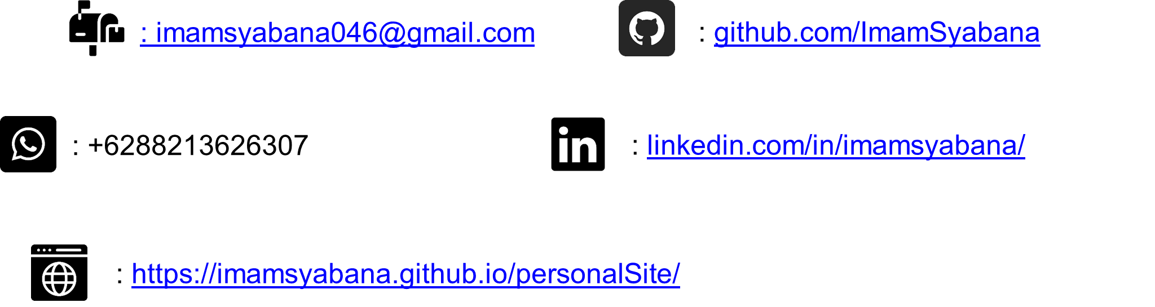
Eklipse AI Data Optimization Test
Muhammad Imam Ariq Sya’bana
Google Slides Link:
https://docs.google.com/presentation/d/1IIDyjt1Fbf55ENQ7aAZHu_nTxcw3ZKBtAE1-3--F7VE/edit?usp=sharing

Slide 2
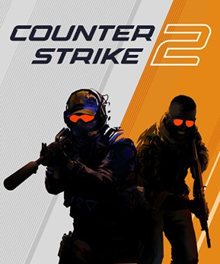
Task 1: Game Understanding
1
Game Selection: Counter-Strike 2

Slide 3
2
Event Identification
In a regular Counter-Strike 2 gameplay, there are plenty of action event that are engaging and worth to be captured as a clips for content creator. Those events such as, getting a chain of kills on opponents informed with a kill banners pops up rapidly and huge amount of blasting sound like gunfire and nades explosion can be used as an indicator that define a moment that worth got clipped. The kill notification in a form of kill banner and the gunfire and explosions sound can be used as a cue for the automated gameplay creation tools to save those moments.
3
Event Justification
One of the most important and difficult things in CS 2 is getting frags. If a user manages to get multiple consecutive kills, it shows that they are playing well and possess a good skill set: reflexes, aim, movement, etc. These skills are honed with a lot of practice, so when the user finally accomplishes this, it is definitely worth capturing and recording to be shared with the community.
Counter-Strike 2 also makes for a tense and engaging situation when a massive gunfight kicks off This is when all the players get excited because they need to attack or defend against the opposing team (depending on which side they are on). This scenario often occurs after the attacking side executes a setup phase, where players create a path using utility items such as smokes, flashes, or grenades. This allows them to take over the opponent’s defended site to create space for planting the bomb. This is also a form of displaying strategy, which is obviously a key part of the game that is enjoyed by viewers. These two events need to be recorded and published so that the larger CS2 community is able to watch.

Slide 4

4
Detection Criteria
UI Elements: When the player gets a kill, the UI shows a blinking kill banner, which can be used as a great indicator that a kill has occurred.
Non-UI methods: A massive gunfight can be recognized by its sounds, such as gunfire and grenade explosions.
Trigger: To automatically detect multiple consecutive kills, the automated clip creation tool will note the timing between the player's kills. If the timing is close, it means a chain of kills has occurred. This will trigger the tool to capture the moment. The trigger for recording the setup and clash between both sides is the sound of a gunfight. When these sounds are detected by the tool, they act as a command to start recording the highlight. The recording should include a few seconds before and after the gunfight is first heard. For example, it could record 10 seconds prior to catch the setup phase and 15 seconds after the gunfight begins to capture the battle for the bomb-site.
False Positive Mitigation: Given how much is happening in a round of CS2, the tool might incorrectly detect a kill banner. To minimize this error, the tool can be instructed to restrict its monitoring to the specific area of the UI where the kill banner appears. A detection box can be used to focus on changes only in the relevant area of the UI.
Clip Parameters (This section was labeled Detection Criteria): The user should be able to remap the key binding used to activate the automated clip creation so that it won't conflict with other key bindings the user has set. After a clip is recorded, it should be saved in a folder called "Eklipse," and the clip name should use the format YYYY.MM.DD – HH.mm.ss.

Slide 5
Task 2: AI-Powered Video Game Data Enhancement
Task: The expected result was to take this minimal information and add valuable data to make the dataset more useful with the addition of genre, short_description, and player_mode information for each game.
To achieve the goal, the process was broken down into several programmatic steps using the Google AI Studio API to generate new data points for each game title:
Creating new genre column that is going to be filled with one word main genre of the game generated by designing a prompt for the API.
A short_description column was also created in order to store a brief summary of the game, with a strict constraint that the description must be under 30 words.
Player mode field is also created to generate information whether the game can be played together with others or not or can be played both solo or together.
The three column’s generated records of data is formed as one dataframe to merge with the starting data. And the final step was to save the enhanced Pandas DataFrame into a new CSV file.
1
Introduction: Task & tools
Introduction: The primary objective of this task was to use the Google AI Studio API to enrich a basic video game dataset. The provided data was a CSV file containing only two columns: game_title, which is the title of the game, and image_url, a link to the game's thumbnail.
Tools:Progamming Language: Python 3.13.5
Data Manipulation: Pandas library 2.3.1 for loading and managing the CSV data.
AI Engine 1.28.0: Google AI Studio API, utilizing the Gemini family of models.
Secure Authentication: Used Environment Variables to safely manage the API key, as required by the project instructions.

Slide 6
2
Prompt Engineering
Prompt engineering is the art and science of designing effective inputs (prompts) to guide a Generative AI model toward a desired output. A vague prompt will produce a creative but unpredictable response. Otherwise, a specific prompt will produce a precise, useful, and predictable response.
Examples of bad prompts and the reason
An example of a bad prompt can be seen when requesting the model to generate genre column using this prompt “Tell me about the game '{game_title}'!". This output is completely not explicit. The Python script cannot easily read this paragraph and determine that the user expecting a single-word genre for the genre column such as "Shooter", “Action”, or “RPG”. The script would need more specific keyword added to the prompt to find the right word.
Similarly, when requesting the model to give a description of the game. The prompt "Describe '{game_title}'" is a very general way of asking to describe the game and could be too vague, because it has no clear boundaries or constraints. This result the model to return a long, multi-sentence paragraph detailing each aspect the game. That prompt will not satisfy the need of short description of the game that has less of 30 words.

Slide 7
2
Prompt Engineering
Examples of good prompts and the reason
The good example to successfully generate a single-word genre for each game title is to use this kind of prompts, "Classify the video game '{game_title}' into a single, common genre (e.g., 'RPG', 'Shooter', 'Strategy'). Respond with only the single-word genre." This prompt is far more effective because it give a command to classify the game title into just one genre type. And because the prompt also explicitly demands a “single-word genre”, this will not upset the model and ensure the model return the title genre presented with only a single-word. The prompt also included examples to guide the model better. This ensures the output is clean, predictable, and ready to be inserted directly into the CSV.
Similar with the case of requesting the model to describe a short explanation about the game, the prompts must be clear of misunderstanding. A good example is this prompt “In your own words, write a unique and creative short description for the video game '{game_title}'. The description must be under 30 words.'". This prompt strictly limit the model to be able to give a full explanation about the game without going over the 30 words.

Slide 8
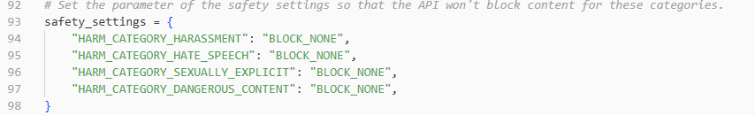
3
Challenges & Solutions
A challenge appear when I was hitting the API rate limit. I initially tried using the 'Gemini 2.5 Pro' model, but its Free Tier limit of 100 requests per day was insufficient to process all 50 games. The solution was to switch to the 'Gemini 2.5 Flash-Lite' model, which offers a much higher free-tier limit of 1,000 requests per day, allowing the entire task to be completed without needing to immediately enable a paid plan.
In addition i also hit the Request Per Minute (RPM_ limit that the model ‘Gemini 2.5 Flash-Lite’ has. To solve that problem, I set a 6 seconds delay timer between each requests to prevent i got the 15 RPM limit.
API Safety Blocks built into the API always block the request for game titles that contain sensitive words like "death" or "assassin." As a result, the API returned an empty response, which left the genre, short_description, and player_mode fields blank for those entries. The solution was to implement custom safety_settings to adjust the main harm category filters, which allowed the requests to be processed correctly.

Slide 9
4
Conclusion & Reflections
I learnt that prompt specificity is crucial because the accuracy of the instructions provided to the AI directly affects the quality of the automated output. I have to be very specific with the prompts, better instructions leads to the better answers the model will produce.
It also made clear that in order to overcome API obstacles like safety blocks without script failure, a strong knowledge about safety blocks parameter setting is a must. When I did not use the safety blocks parameter setting at all, i got an error that the models will not return the game title that has a sensitive words. So the improvement i made is to clearly define the harm category harassment, speech, sexually explicit and dangerous content to BLOCK_NONE.
Initially, my script made API calls as fast as possible, without any time delay between them. This quickly led to a "429: Too Many Requests" error because the script was exceeding the Requests Per Minute (RPM) limit defined in the model's free tier. This experience highlighted how critical it is to research and understand an API's rate limits, especially for larger projects. After learning the specific RPM for the model, the solution was to implement a simple six-second time.sleep() delay after each API call. This small addition ensured the script operated within the allowed quota, preventing rate limit errors and allowing the process to complete successfully.

Slide 10
Task 3: Data Analysis
Metric 1: User activation percentage
This metric measures the percentage of users who submit a game session. This metric shows a percentage of users who signed up and also managed to use the game session submission feature. Tracking this metrics also gives the information about how effective the onboarding process service is. If the metrics shows a high number, in this case 91.86% then the feature has an intuitive user interface. On the contrary, if the number is low then it tells that there is a problem, such as a confusing user interface or technical bugs in the submission process
Metric 2: Form of downloaded clip distribution
Eklipse offers multiple option to generate clips (AI highlights, TikTok conversions, vertical clips from Youtube, etc.). Knowing which form of media of clips are downloaded most often provides direct feedback on which features users find most valuable. This information is crucial for making decisions about which form of media to invest more time and resources so that the improvement is efficient and satisfy the majority user. This metric also shows which form of media has less download number and need a feature improvement to make it more appealing.
Metric 3: Free-to-Premium Conversion Rate
This is a monetization monitoring metric. It measures the effectiveness of value that offered to the user by showing what percentage of the whole user finds enough value in the service to pay for it. This percentage can be used as a Key Performance Indicator (KPI) do decide whether the premium features are well-priced or it needs to add more exclusive features, adjusting the price, or more advertising that highlight the benefits of upgrading.

Slide 11
Metric 4: Premium User Churn Rate
This metric is a direct indicator of customer satisfaction with the premium plan. A high churn rate is a major warning sign that users aren't finding long-term value in the paid features, which could be due to bugs, a lack of new features, or a competitor offering a better service. Keeping this number low is essential for stable revenue.
Metric 5: Top 10 Games with Most Shared Clips
Sharing clips generated from the Eklipse can be a powerful form of marketing. When the users sharing their highlight clips, they also promoting Eklipse to their own network. This metric identifies which game communities can be the number one Eklipse’s popularity promoter. This help to direct the advertising on the communities that are most likely to grow Eklipse’s popularity.

